Slide 1
Web Server Design Week 1 – Fun with GitHub/Git
Old Dominion University
Department of Computer Science
CS 431/531 Fall 2018
Michael L. Nelson <mln@cs.odu.edu>
2018-08-29

Slide 2
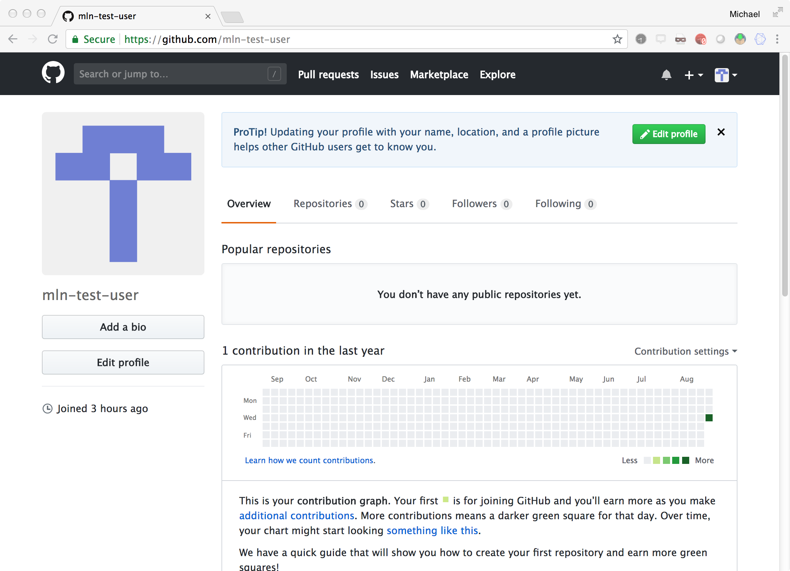

Slide 3
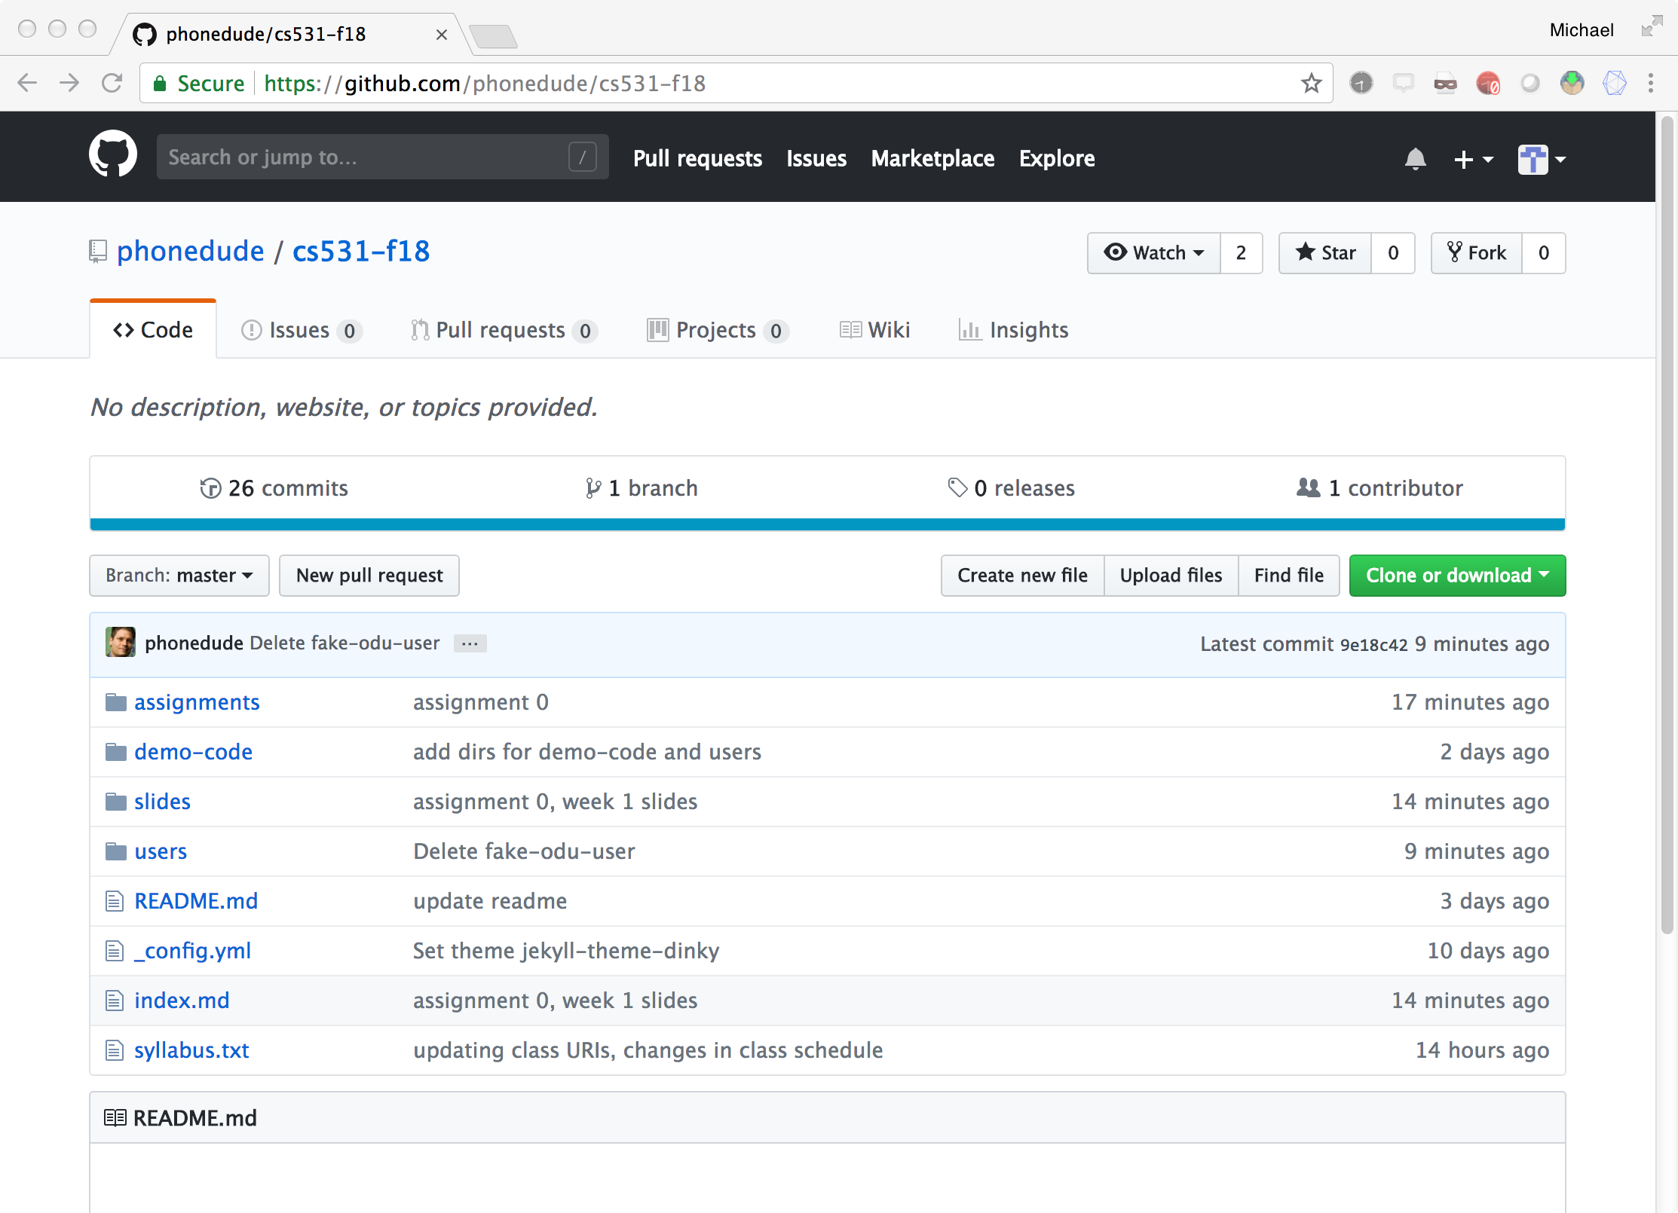

Slide 4
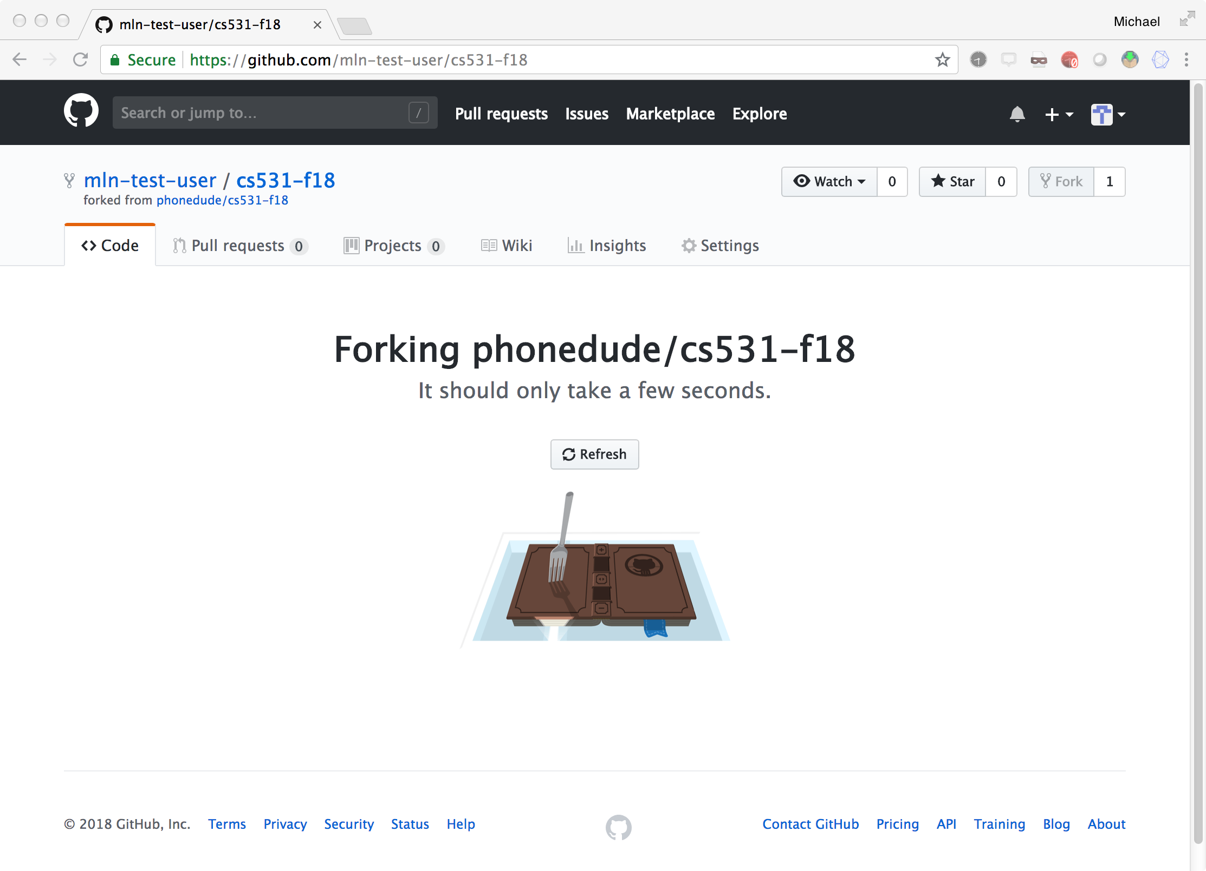

Slide 5
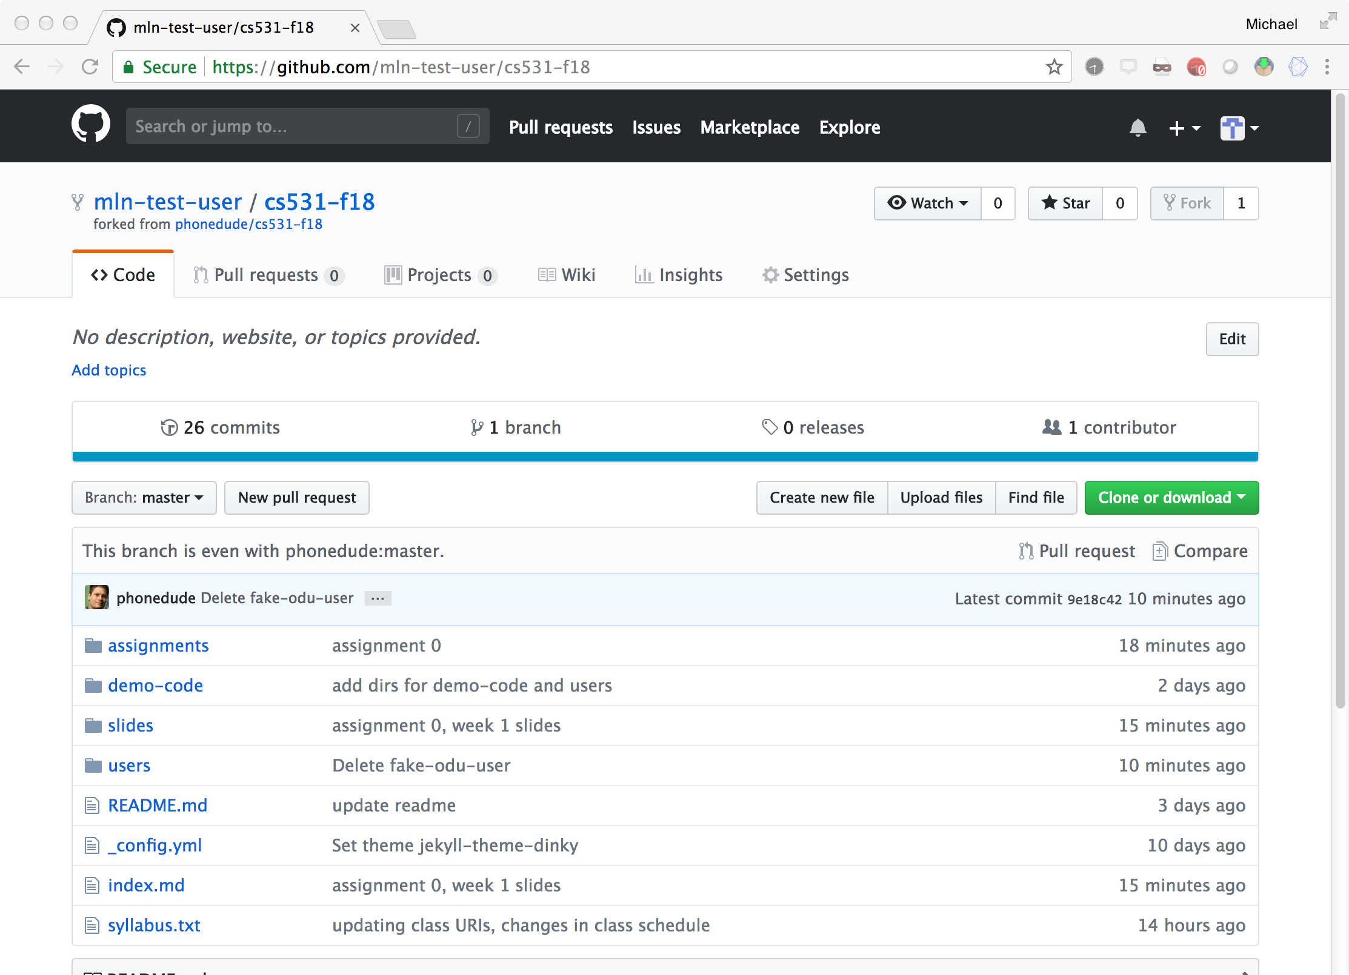

Slide 6
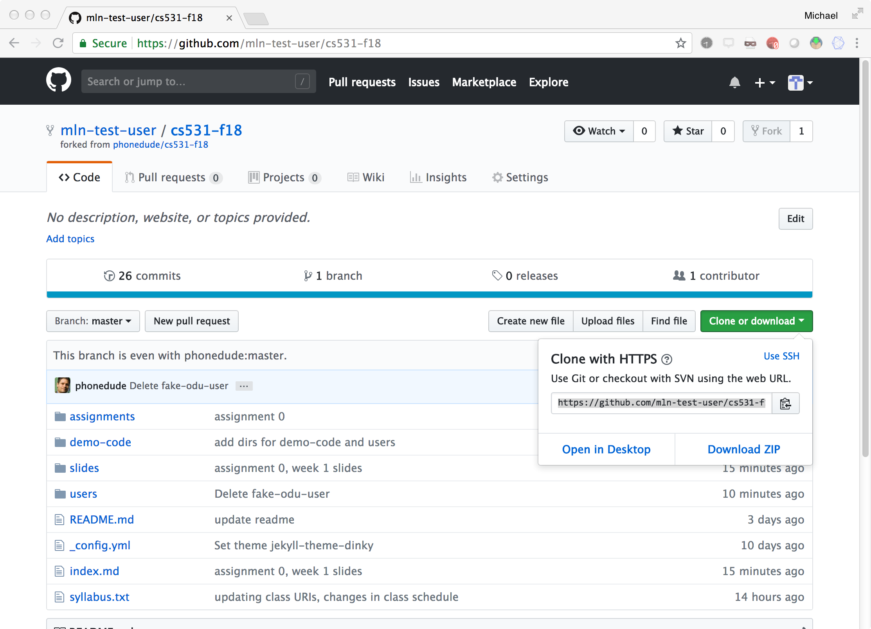

Slide 7
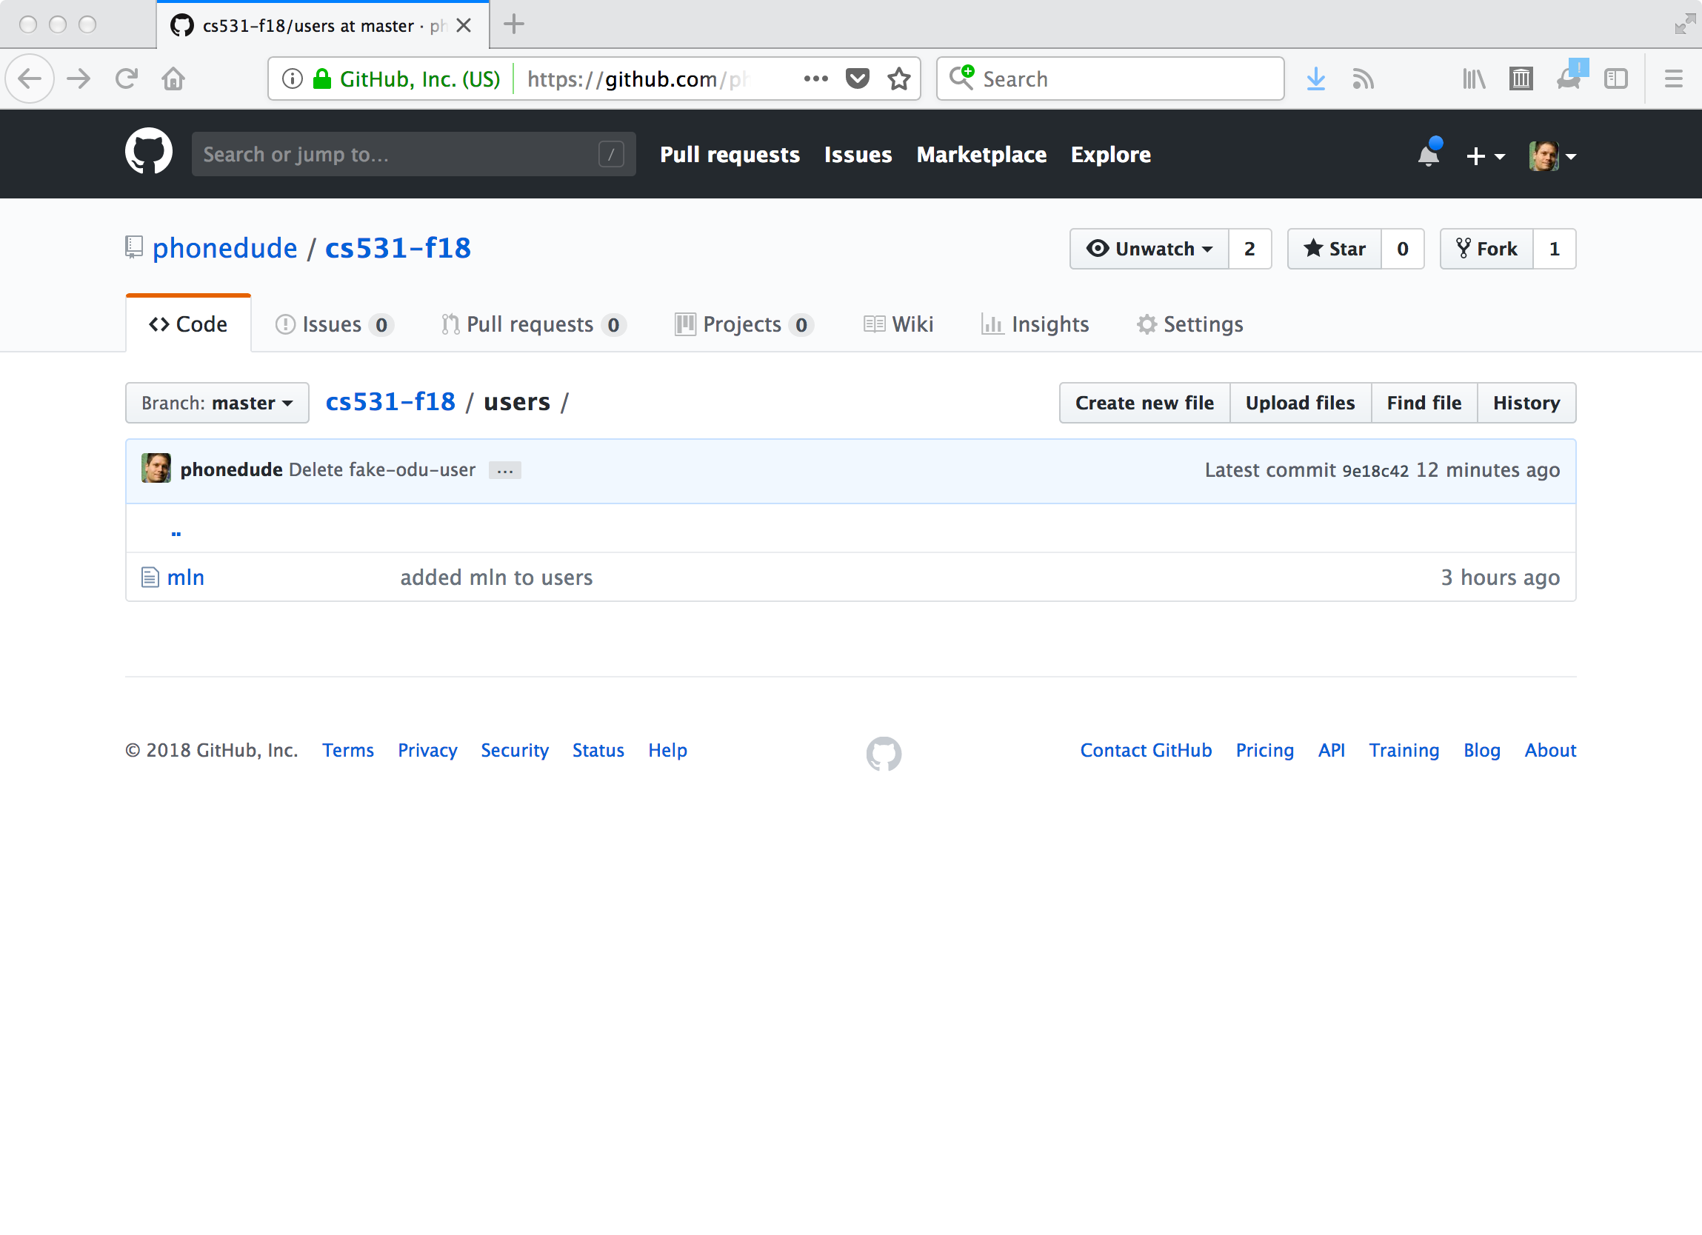

Slide 8
The more you can do from the command line, the better

Slide 9
sirius:/home/mln/hold/cs531-f18 % script git-session
Script started, file is git-session
sirius:~/hold/cs531-f18> git clone https://github.com/mln-test-user/cs531-f18.git
Cloning into 'cs531-f18'...
remote: Counting objects: 87, done.
remote: Compressing objects: 100% (55/55), done.
remote: Total 87 (delta 37), reused 59 (delta 17), pack-reused 0
Unpacking objects: 100% (87/87), done.
Checking connectivity... done.
sirius:~/hold/cs531-f18> ls
cs531-f18/ git-session
sirius:~/hold/cs531-f18> cd cs531-f18/
sirius:/home/mln/hold/cs531-f18/cs531-f18 % ls
assignments/ _config.yml demo-code/ index.md README.md slides/ syllabus.txt users/
sirius:/home/mln/hold/cs531-f18/cs531-f18 % cd users
sirius:/home/mln/hold/cs531-f18/cs531-f18/users % ls
mln
sirius:/home/mln/hold/cs531-f18/cs531-f18/users % cat > odu-fake-acct-name
https://github.com/mln-test-user/cs-431-fall-2018
sirius:/home/mln/hold/cs531-f18/cs531-f18/users % cd ..

Slide 10
sirius:/home/mln/hold/cs531-f18/cs531-f18 % git add users/odu-fake-acct-name
sirius:/home/mln/hold/cs531-f18/cs531-f18 % git commit -m "added odu-fake-acct-name"
[master c3f77ed] added odu-fake-acct-name
Committer: mln-test-user <mln@cs.odu.edu>
Your name and email address were configured automatically based
on your username and hostname. Please check that they are accurate.
You can suppress this message by setting them explicitly:
git config --global user.name "Your Name"
git config --global user.email you@example.com
After doing this, you may fix the identity used for this commit with:
git commit --amend --reset-author
1 file changed, 1 insertion(+)
create mode 100644 users/odu-fake-acct-name
sirius:/home/mln/hold/cs531-f18/cs531-f18 % git push origin master
Username for 'https://github.com': mln-test-user
Password for 'https://mln-test-user@github.com':
Counting objects: 6, done.
Delta compression using up to 16 threads.
Compressing objects: 100% (4/4), done.
Writing objects: 100% (4/4), 391 bytes | 0 bytes/s, done.
Total 4 (delta 1), reused 0 (delta 0)
remote: Resolving deltas: 100% (1/1), completed with 1 local object.
To https://github.com/mln-test-user/cs531-f18.git
9e18c42..c3f77ed master -> master
sirius:/home/mln/hold/cs531-f18/cs531-f18 % Script done, file is git-session
sirius:/home/mln/hold/cs531-f18 %

Slide 11
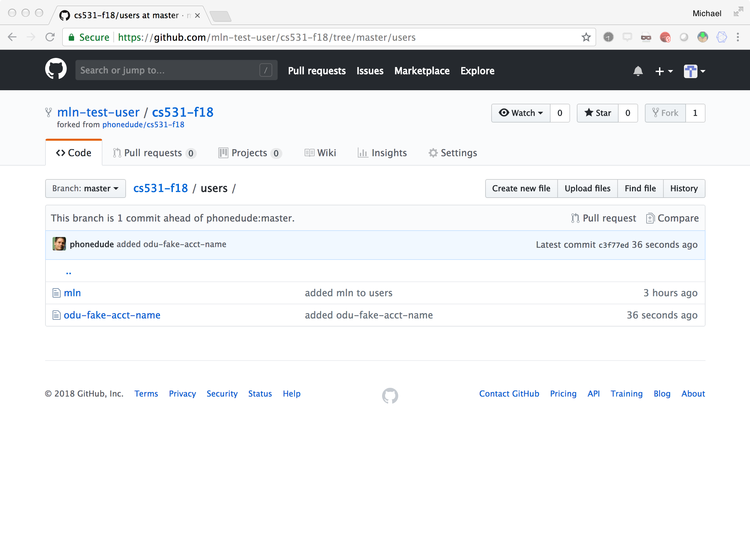

Slide 12
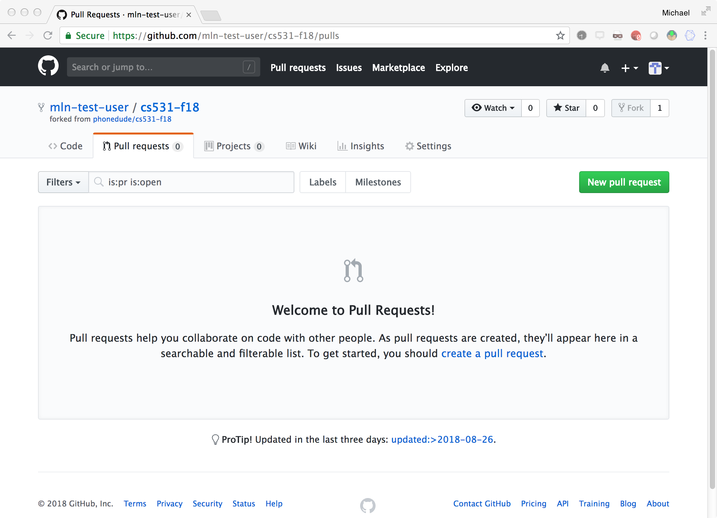

Slide 13
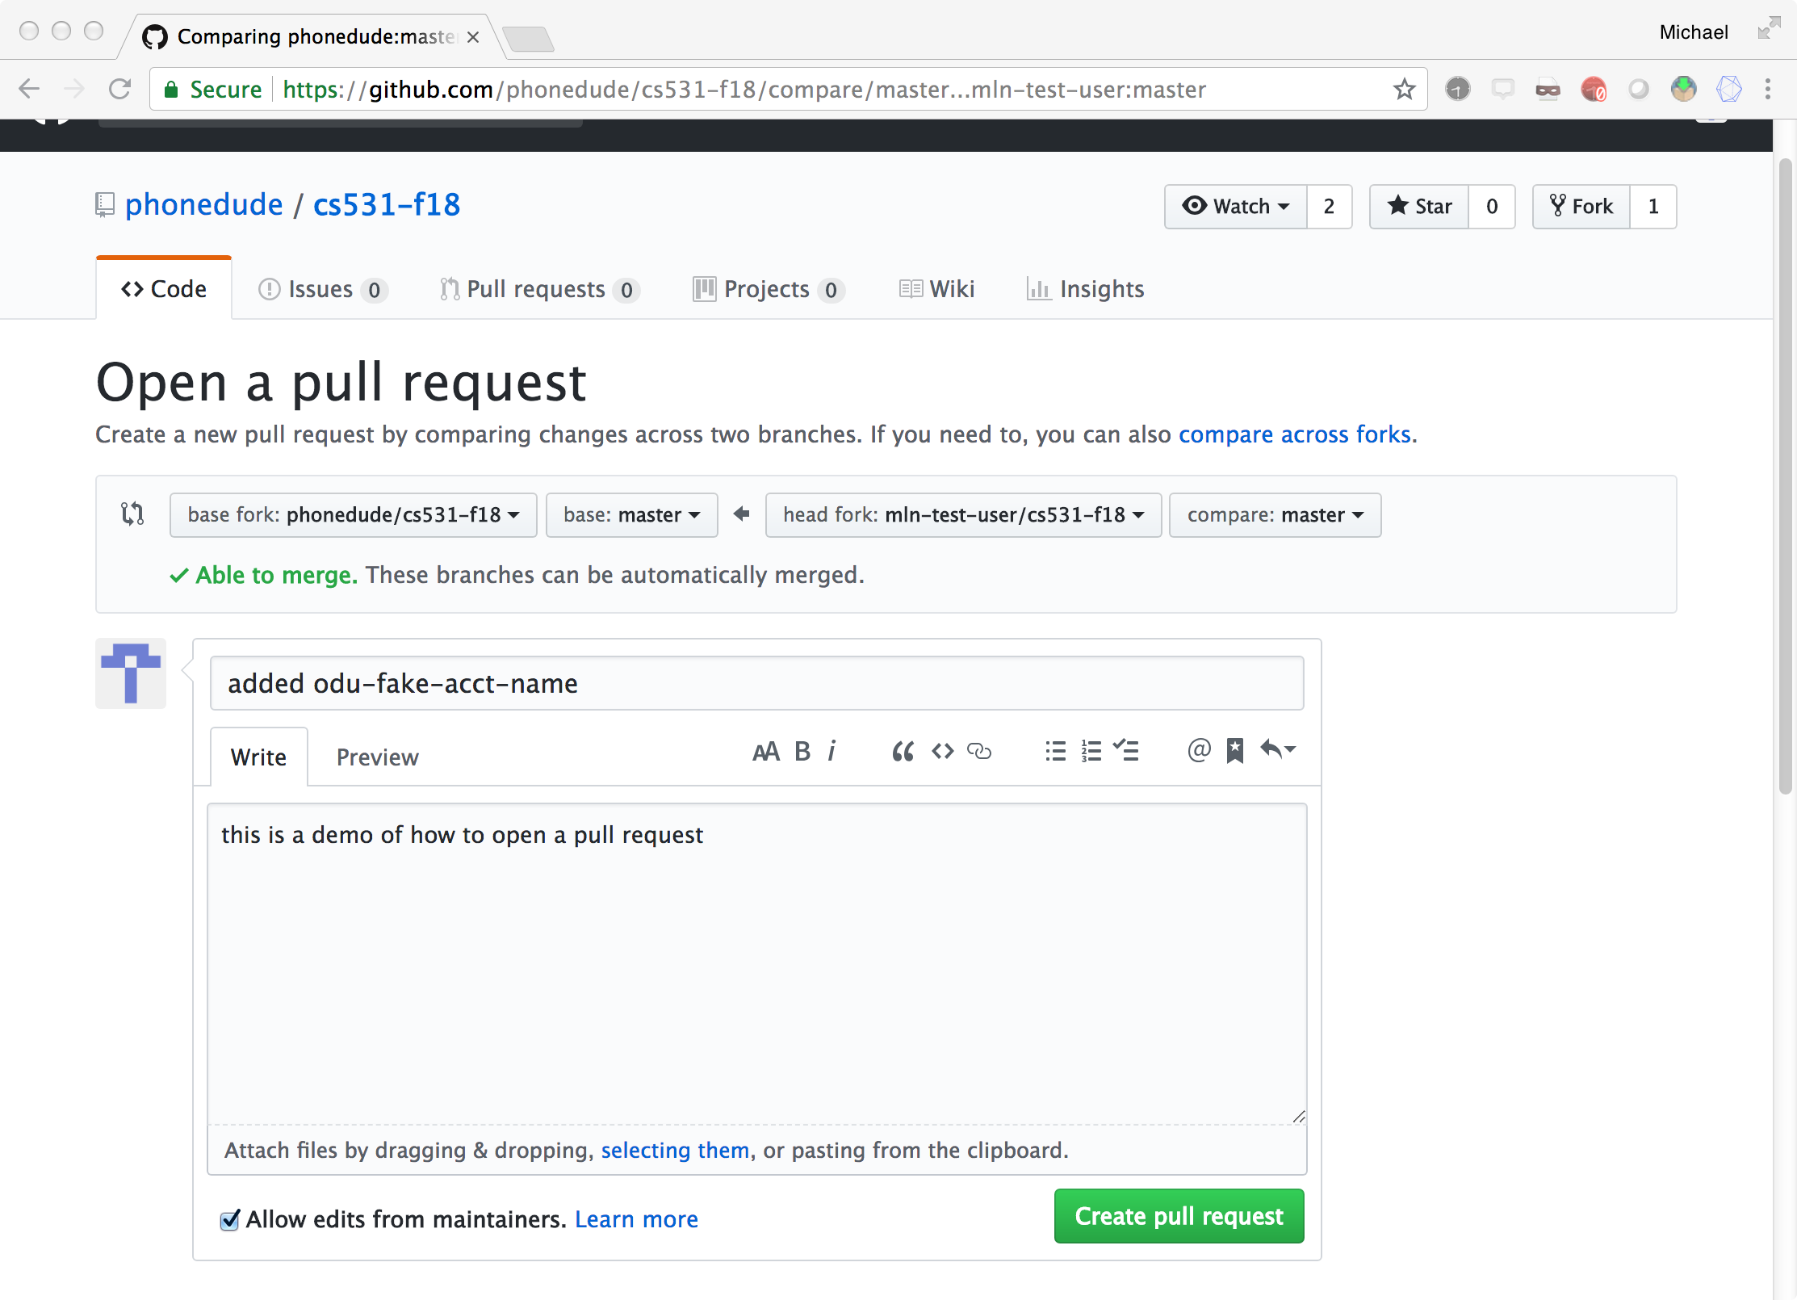

Slide 14
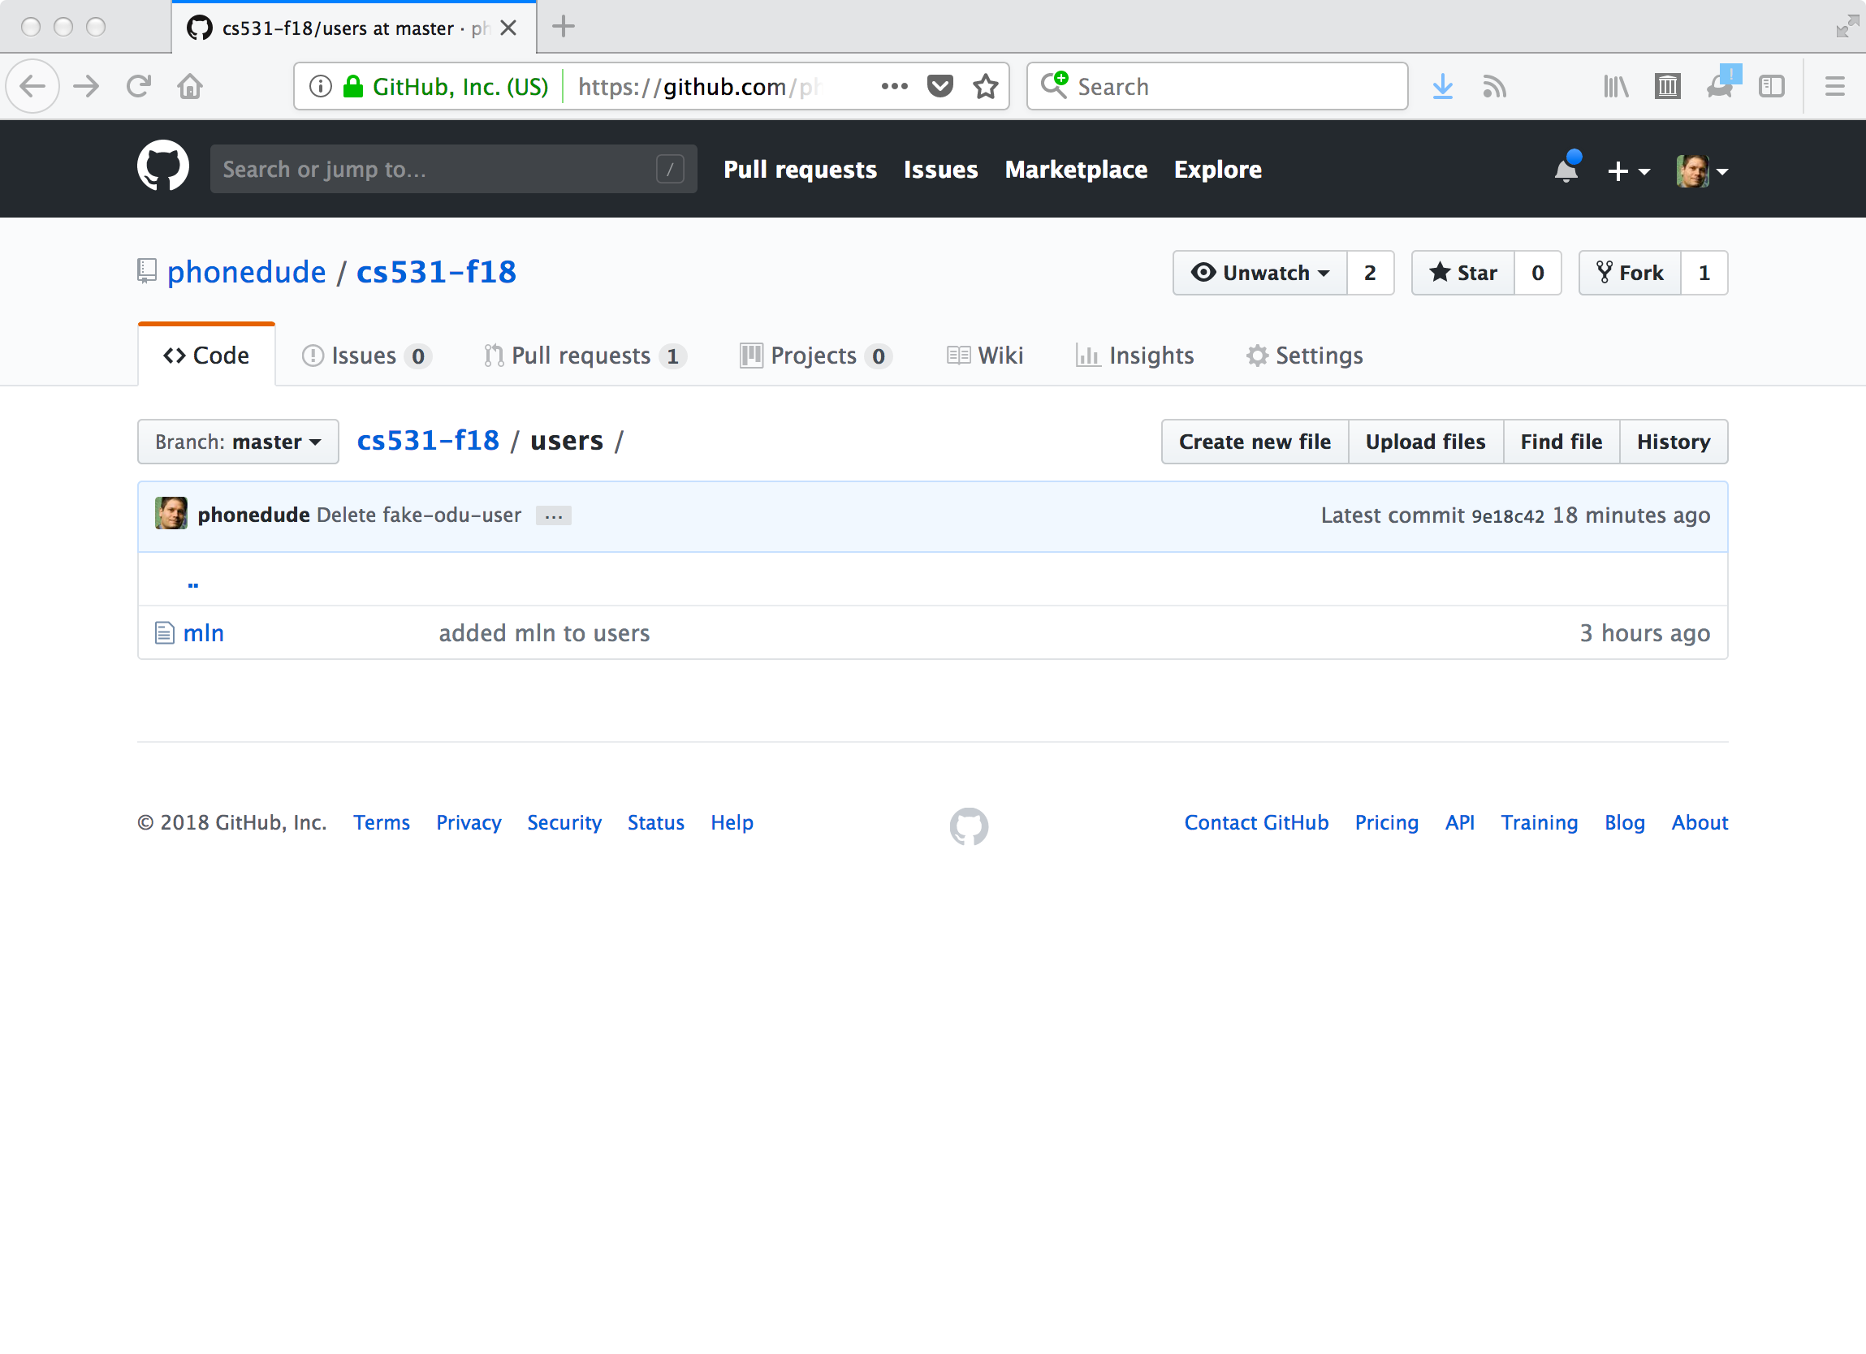

Slide 15
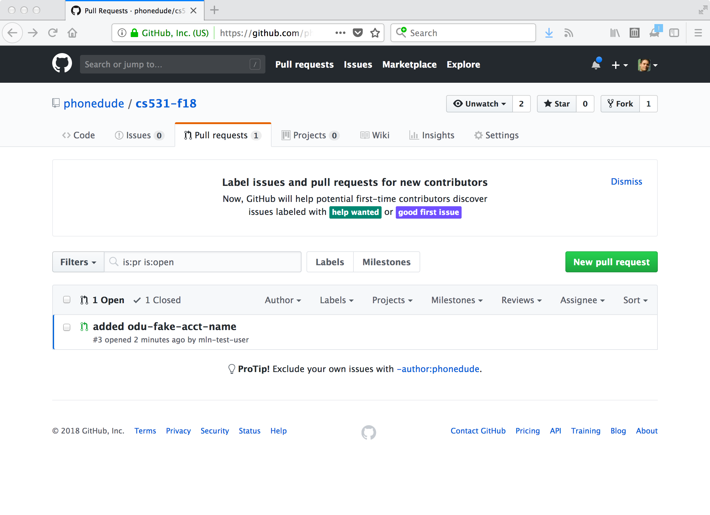

Slide 16
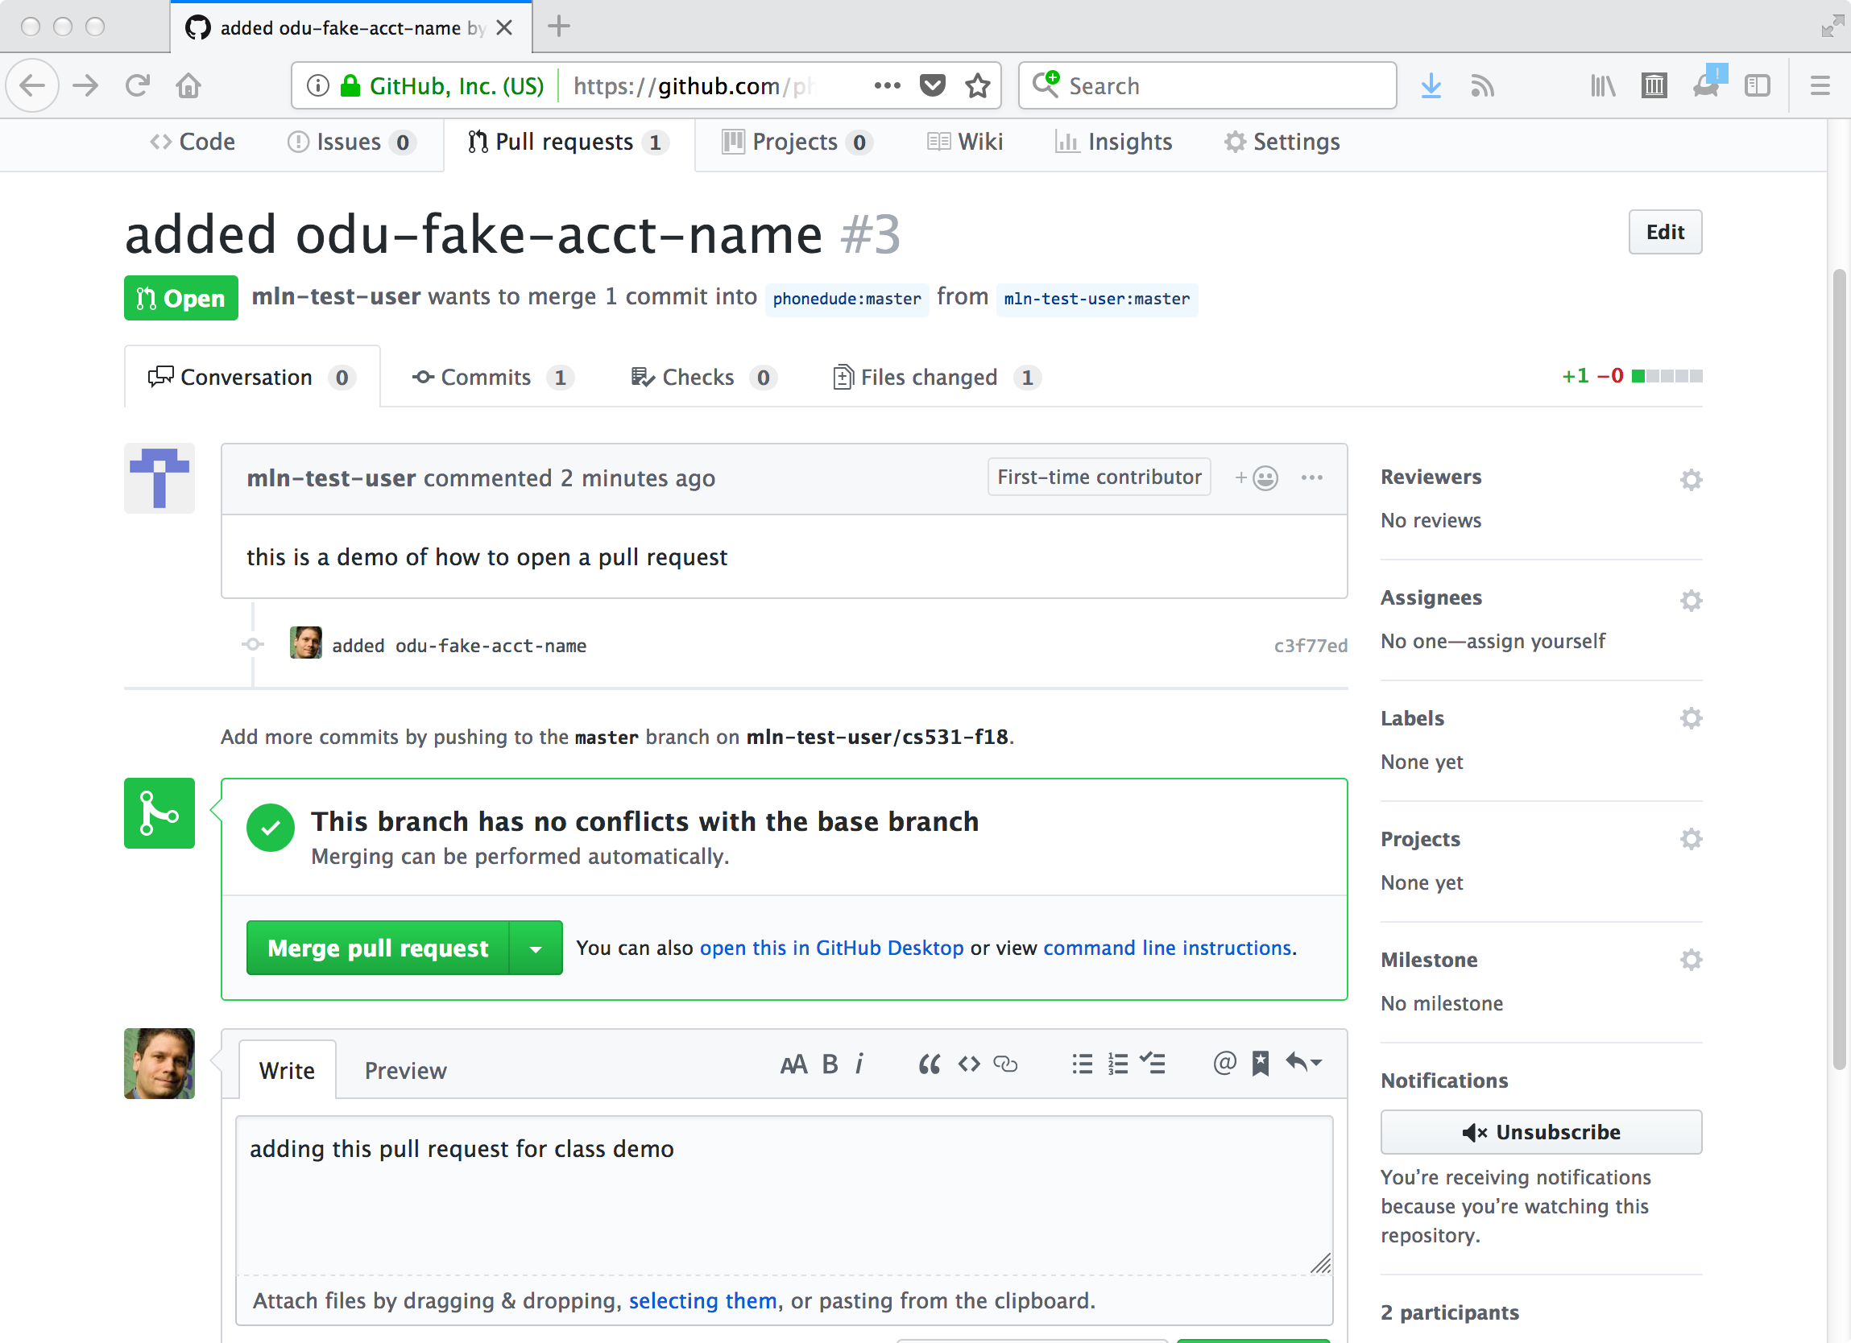

Slide 17
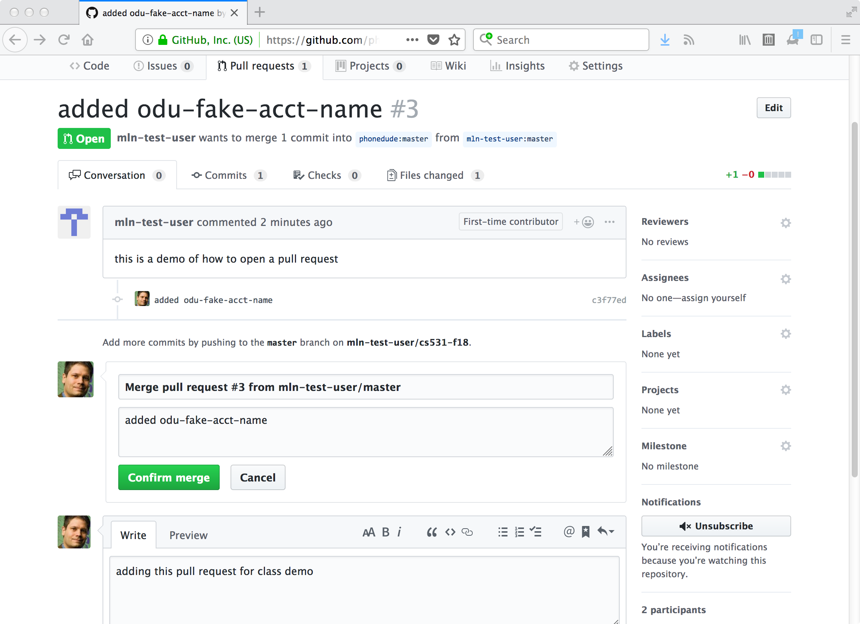

Slide 18
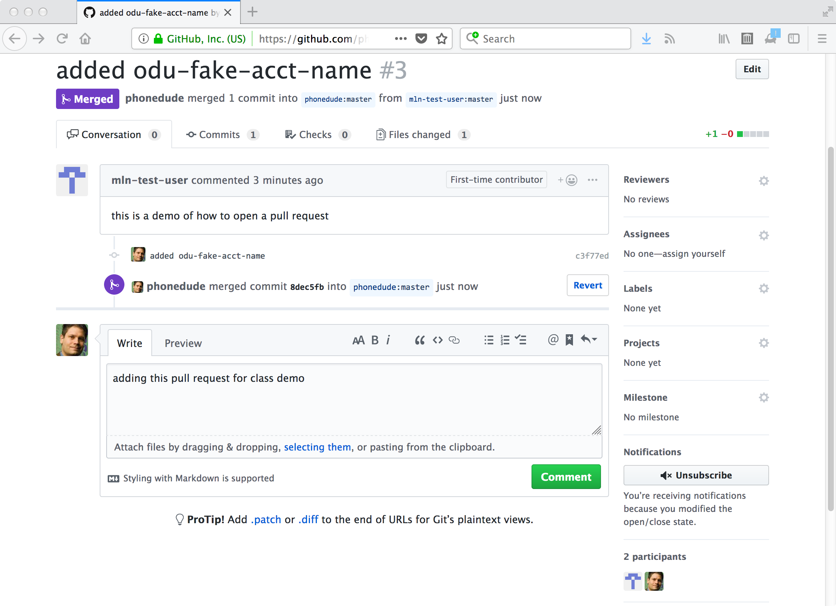

Slide 19
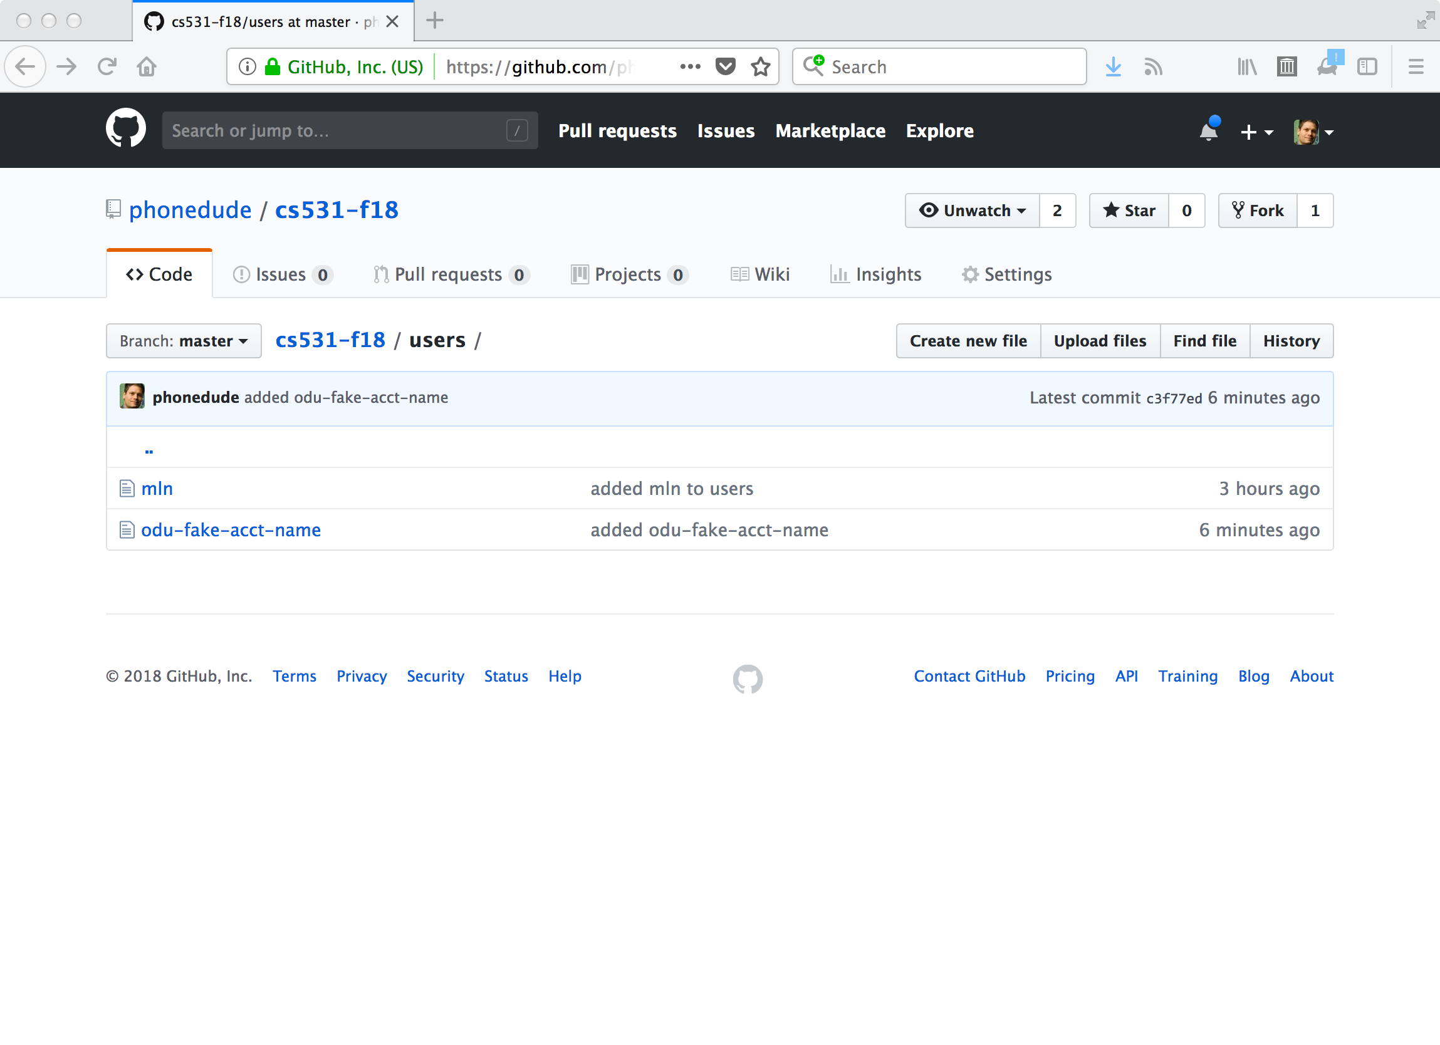

Slide 20
Michael-Nelsons-MacBook-Pro-2:cs595-f18 mln$ pwd
/Users/mln/Desktop/cs595-f18/class-info/cs595-f18
Michael-Nelsons-MacBook-Pro-2:cs595-f18 mln$ ls
README.md assignments index.md syllabus.txt
_config.yml demo-code slides users
Michael-Nelsons-MacBook-Pro-2:cs595-f18 mln$ ls users
mln
Michael-Nelsons-MacBook-Pro-2:cs595-f18 mln$ git pull
remote: Counting objects: 8, done.
remote: Compressing objects: 100% (6/6), done.
remote: Total 8 (delta 2), reused 5 (delta 1), pack-reused 0
Unpacking objects: 100% (8/8), done.
From https://github.com/phonedude/cs595-f18
4ee5135..8dec5fb master -> origin/master
Updating 4ee5135..8dec5fb
Fast-forward
users/fake-odu-user | 1 -
users/odu-fake-acct-name | 1 +
2 files changed, 1 insertion(+), 1 deletion(-)
delete mode 100644 users/fake-odu-user
create mode 100644 users/odu-fake-acct-name
Michael-Nelsons-MacBook-Pro-2:cs595-f18 mln$ ls users
mln odu-fake-acct-name
Michael-Nelsons-MacBook-Pro-2:cs595-f18 mln$ cat users/odu-fake-acct-name
https://github.com/mln-test-user/cs-431-fall-2018
Michael-Nelsons-MacBook-Pro-2:cs595-f18 mln$

